Slide 1

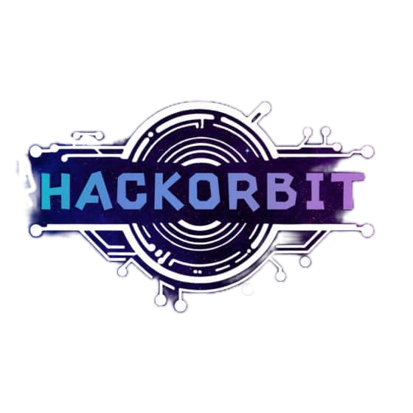




HackOrbit 2025
Team Name - ILLUMINATI
Team member 1 - Zodrick John (Team Lead) mob – 7302372880
Team member 2 - Mohd Aanas
mob – 6399493891
Team member 3 - Farahim mob - 9557198020
Click for demo video

Slide 2

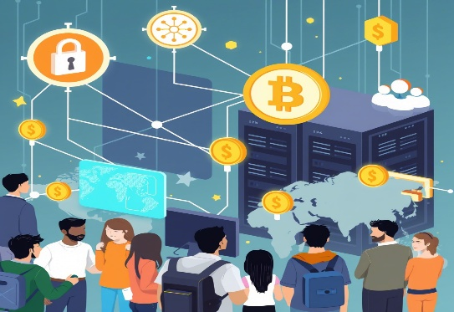


THEME & PROBLEM STATEMENT
The Compute Crisis: Power Wasted, Potential Lost
CHALLENGE
Access to high-performance computing is expensive, centralized, and largely inaccessible to students, indie developers, and under-resourced regions.
WHY IT MATTERS
60% of personal devices remain idle for most of the day. (Source: Intel Developer Survey 2022)
AI, 3D rendering, and large-scale computations are now part of everyday R&D — yet cloud costs (AWS, GCP) create a paywall for innovation.
PROBLEM’S IMPACT
Limiting creativity and innovation due to infrastructure bottlenecks.
Creates digital inequality in education and development opportunities.
“ In 2023 alone, global demand for compute power grew by 26%, while accessibility remained flat.”
- IEEE Report

Slide 3
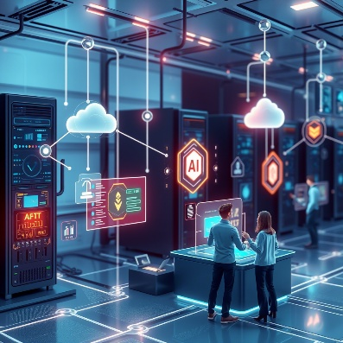


PROPOSED SOLUTION
CoreIT – Compute without limits
WHAT WE BUILD
CoreIT - A decentralized platform to rent and utilize idle compute power for AI, graphics, or large-scale data tasks
HOW IT WORKS
Connects users needing compute (students, devs) with providers (PC owners with spare power).
Secure, incentive-driven, real-time remote execution.
UNIQUE ADVANTAGE
🧩 Blockchain-based trust.
🔐 Encrypted code execution & result delivery.
💸 Provider incentives via microtransactions.

Slide 4
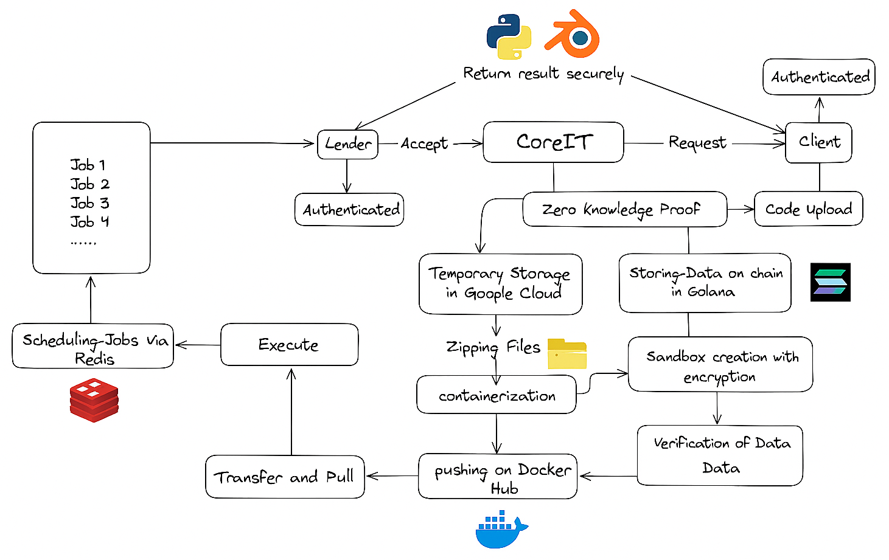
CoreIT’s Flow of Execution
🔐 Client Side
1. Client → CoreIT
The client authenticates and uploads code via CoreIT.
CoreIT uses Zero Knowledge Proof to maintain privacy and security.
🔁 Feedback Loop
Results are returned securely to the client (Python/Blender jobs, possibly visualization-related).
⚙️ Job Execution
8. Transfer and Pull
The containerized job is pulled from Docker Hub.
9. Execute
Job execution happens.
10. Scheduling Jobs via Redis
Job scheduling and queuing handled by Redis.
11. Execution results → Returned Securely
Final results are sent securely back to CoreIT → Client.
📦 Code Handling and Storage
2. CoreIT → Temporary Storage (Google Cloud)
Uploaded code is stored temporarily.
Files are zipped and containerized.
Container is pushed to Docker Hub.
🧪 Sandbox & Blockchain
3. CoreIT → Store Data on Chain (Solana)
CoreIT also stores metadata/data on Solana blockchain.
4. Sandbox Creation with Encryption
A secure sandbox is created for the job using encrypted environment.
5 .Verification of Data
Sandbox performs data verification before execution.
🖥️ Lender Side (Compute Providers)
6. Lender (Authenticated) Accepts Jobs
Jobs like Job1, Job2, etc., are offered to available lenders.
7. Lender → CoreIT
Lender accepts and retrieves the container securely.

Slide 5
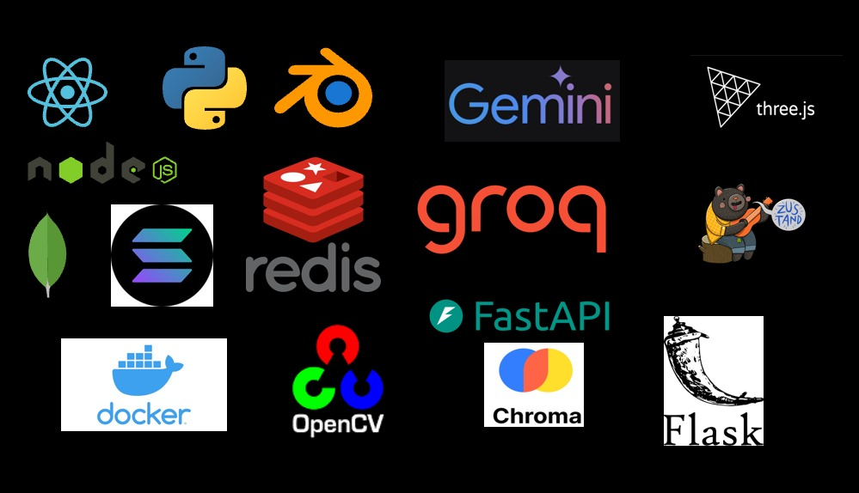
Tech Stack
👩‍💻 Languages & Core Frameworks
Python – for model handling, backend APIs
Node.js – task orchestration, API logic
React.js – clean, modular frontend
FastAPI / Flask – blazing-fast RESTful endpoints for Python services
Three.js – advanced 3D rendering UI
Blender – 3D modelling and rendering pipeline
Zustand – state management for React apps
🔐 Security, APIs & Dev Tools
Docker – containerized, isolated task environments
Chroma – managing embeddings and retrieval of past code/data
Gemini / Groq – AI integration for code summarization, risk scoring
Solana – decentralized identity/auth and provider rewards via blockchain
🎥 CV & Vision Toolkits
OpenCV – for real-time visual processing (e.g., checking GPU health visually via webcam feed)
CoreIT VS Code Extension – plugin for remote code execution
📦 Databases & Caching
MongoDB – primary NoSQL database for user sessions, devices, logs
Redis – ultra-fast caching for task queues and status tracking

Slide 6
Features
Novelity
🔁Remote Execution
Removes the need for costly cloud platforms like AWS/Colab.
🌟 What Makes CoreIT Novel?
🔐 Zero-Knowledge Proofs (ZKP) for Trustless Execution Ensures the lender never sees the raw code — enabling secure compute sharing without blind trust.
⛓ Solana-Based Immutable Logging Execution metadata is logged to blockchain for auditable, tamper-proof tracking.
💻 Monetization of Idle Personal Hardware Turns high-performance but underutilized PCs into income-generating nodes in a decentralized grid.
🧠 AI-Ready Infrastructure Designed with heavy workloads (AI training, 3D rendering) in mind — not just small code snippets.
🌐 Bridging Web2 UX with Web3 Infrastructure Smooth, app-like frontend (VS Code, React) built on cutting-edge blockchain and cryptographic backend.
🔒 Zero-Knowledge Security
Ensures code privacy even during third-party execution.
🧑‍💻 Developer-Centric Tools
Seamless VS Code integration for submission, tracking, and result review — no setup hassle.
📦 Containerized Environment
Guarantees consistency, sandboxing, and platform independence.
💸 Idle Resource Monetization
Empowers individuals with spare GPU/CPU to earn income securely.

Slide 7
Drawback & Showstoppers
Known Drawbacks
Potential Showstoppers
📶 Dependency on Stable Internet
Remote execution relies on reliable, fast internet at both client and lender ends — a bottleneck in low-connectivity regions.
🧾 Legal & Compliance Barriers
Running unverified code on personal hardware may face regional legal restrictions or violate system warranties.
🔗 Blockchain Scalability & Cost
Relying on networks like Solana for on-chain logging can hit fee spikes or congestion during peak loads.
🧱 Limited Device Availability at Scale
As user demand grows, lender supply may not always match, especially for GPU-intensive tasks.
📦 Execution Latency & Cold Starts
Docker container pull and spin-up time can cause delays, especially for large model/codebases.

Slide 8
Thank you

